Slide 1


AJIO CLONE
WEBSITE
PRESENTED BY:
RISHABH MISHRA (2200271530090)
RUDRA CHAUBEY (2200271530095)
RUJAL RAJ SINGH. (2200271530096)
MOHD. SHAH ALAM (2200271530073)
SUBMITTED TO:
NEEHARIKA TRIPATHI

Slide 2
TABLE OF CONTENTS
Introduction
Objective
Technical Specifications
Module-1
Module-2
Module-3
DFD-1
DFD-2
DFD-3
Workflow
Output
Use Cases

Slide 3
INTRODUCTION
Introducing our AJIO clone website, a revolutionary fashion destination inspired by India's leading conglomerate.
Bringing the best of fashion at unbeatable prices, our platform mirrors AJIO's commitment to affordability and style.
Emphasizing curated styles, we offer a diverse range, handpicked for fashion enthusiasts to make quality decisions.
As a one-stop destination, our AJIO clone redefines online fashion, promising a seamless and enjoyable shopping journey.

Slide 4
OBJECTIVE
Make trendy and quality fashion accessible to a wider audience by providing a diverse and affordable range of clothing and accessories.
Prioritize a seamless and user-friendly interface, ensuring an enjoyable and convenient online shopping experience for customers.
Foster a vibrant online community by integrating social media features, encouraging user engagement, and creating a space for fashion enthusiasts to connect.

Slide 5
TECHNICAL SPECIFICATIONS
Structure the website using HTML to define the layout, headings, paragraphs, and other structural elements.
Utilize semantic HTML for better accessibility and SEO.
Apply CSS for styling and formatting to enhance the visual appeal of the website.
Implement responsive design principles to ensure the website looks good on various devices and screen sizes.
Utilize Bootstrap components such as navigation bars, grids, and modals for a modern and responsive UI.
Enhance user interactivity with JavaScript for client-side scripting.
Implement features like dynamic content loading, image sliders, and form validations to improve the user experience.

Slide 6
MODULE DISCRIPTION
M1
LOGIN:
Firstly User Come To our Home Page of ajio website.
After that user goes to SignIn button.
User fill Authentication Form
After Validate the user’s Details ,User goes to home page of website.

Slide 7
MODULE DISCRIPTION
M2
SELECTION OF PRODUCT AND BUYING:
After SignIn User can Select the Products .
And can Add these Products Into Their Cart .
After adding the product user can checkout the Product .
User Pay the amount of product as shown in Cart .
If the Transaction is Successful then go to Home Page.
Otherwise Redirect to payment page.

Slide 8
DFD -1
LOGIN:
HOME PAGE
USER
LOGIN
NO
YES
VALIDATION?

Slide 9
DFD -2
SELECTION OF PRODUCT:
MAIN WEBSITE
USER
PRODUCT
ADD TO CART ?

Slide 10
DFD -3
BUYING:
MAIN WEBSITE
CART SECTION
USER
YES
PAY NOW
TRANSACTION SUCCESS ?
NO

Slide 11
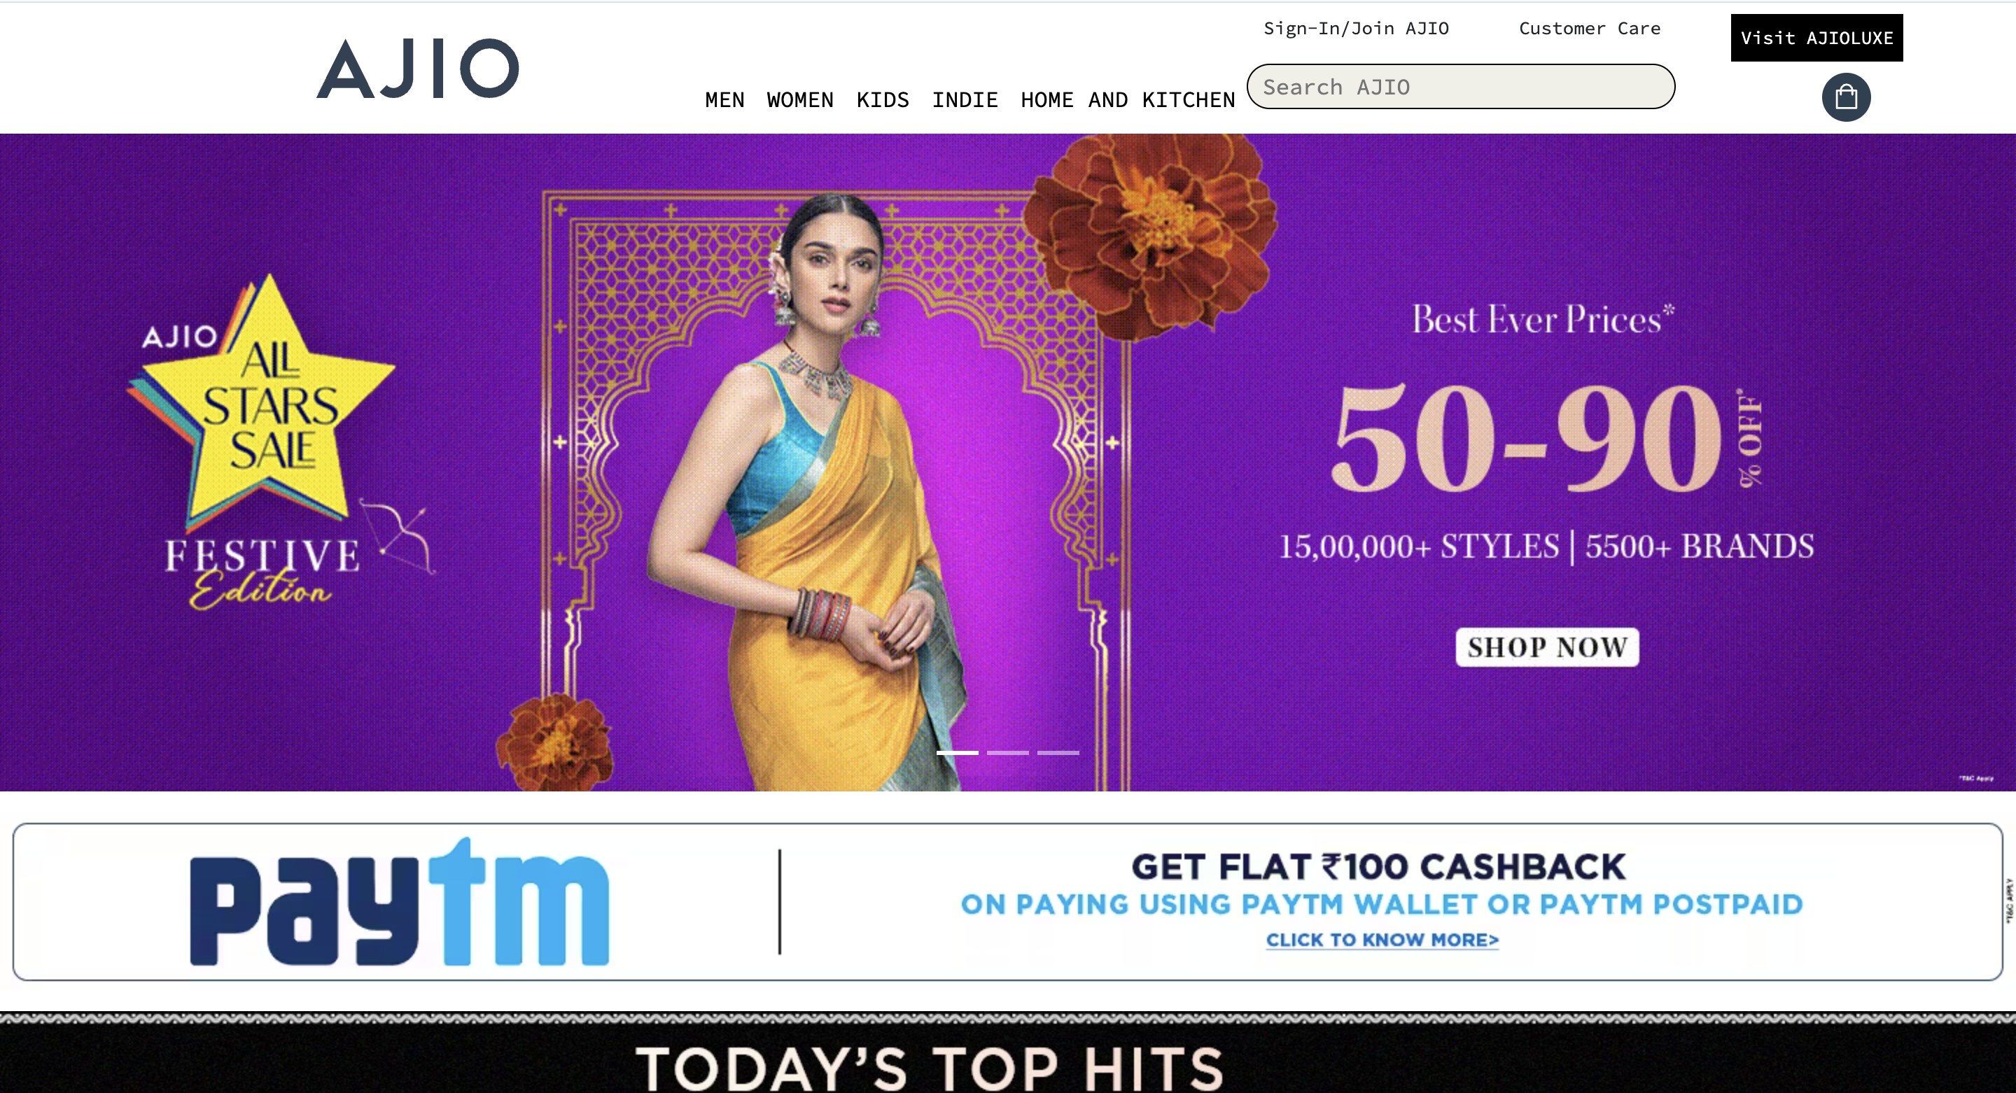

Slide 12
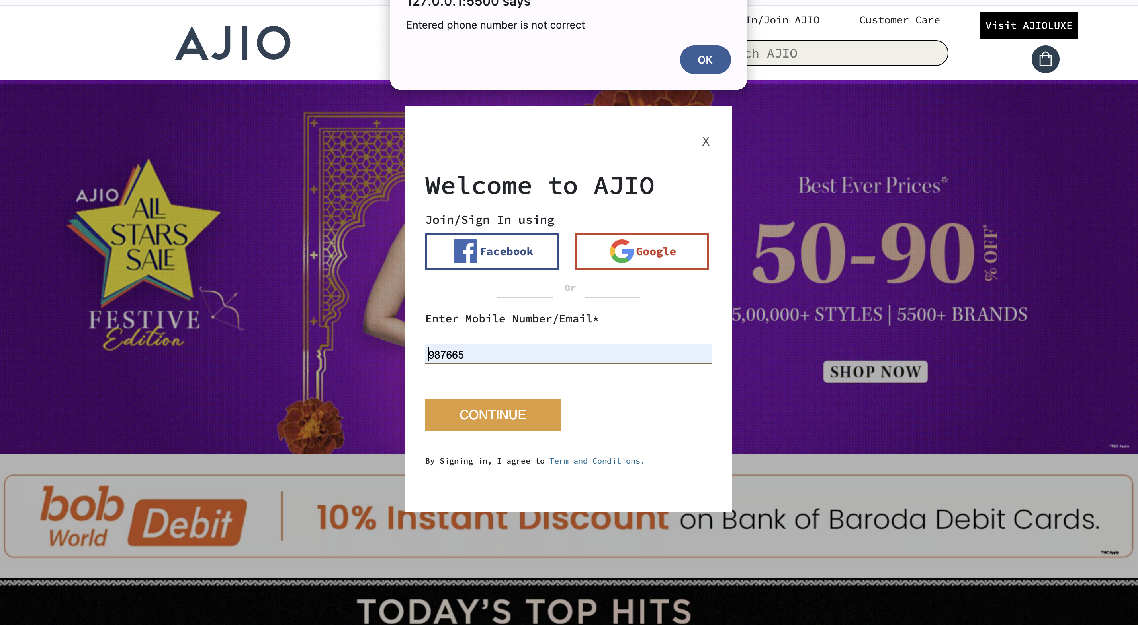
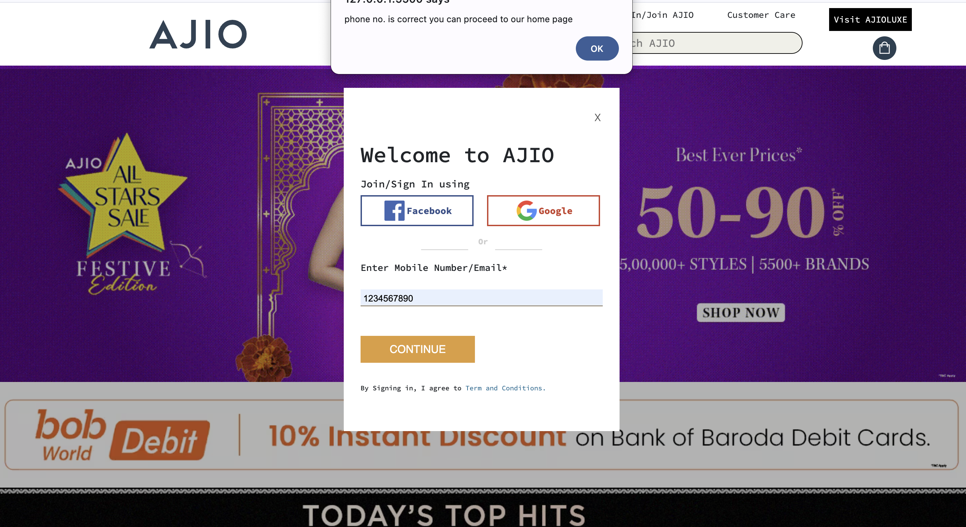

Slide 13
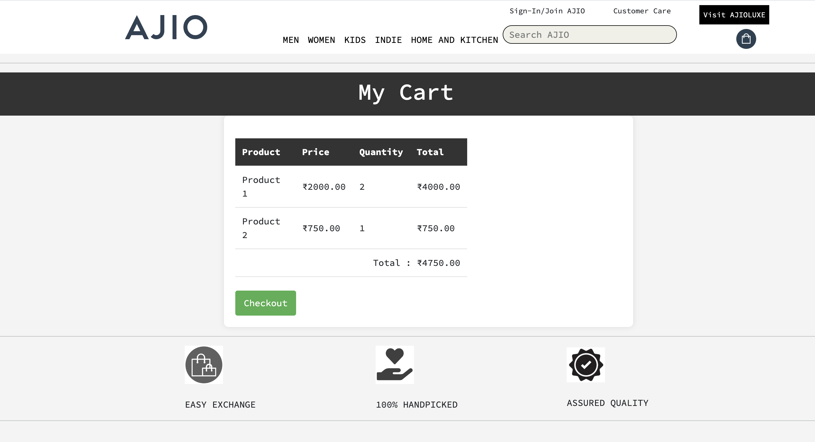

Slide 14
USE CASES
Users can explore a wide range of fashion products, including clothing, accessories, and footwear.
Users can create accounts, manage their profiles, and track order history, providing a personalized and seamless shopping journey.
The website facilitates a user-friendly shopping cart system, allowing users to add, remove, and review items before proceeding to a secure and efficient checkout process

Slide 15
CONCLUSION
Leveraging HTML, CSS, Bootstrap, and JavaScript, the website incorporates cutting-edge technology to ensure responsiveness, interactivity, and a modern user interface.
With a focus on responsive design and scalability, the website is poised for growth, adapting to market dynamics and evolving user preferences.
AJIO clone website not only mirrors the success of its inspiration but also establishes itself as a forward-thinking, user-centric, and technologically advanced fashion destination

Slide 16
